Slide 1


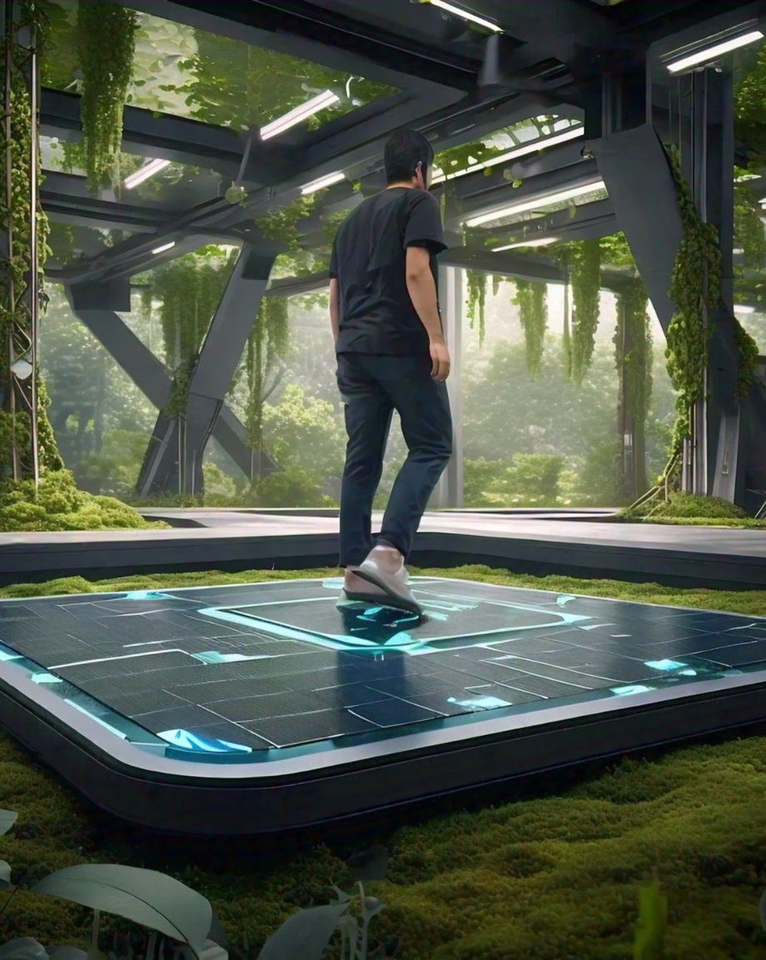

FOOTSTEP
POWER-GENERATION
Presented by:
Sri Harshitha J-22011102030
Kapil Raisoni.A 22011102040
Kishore Chakraborty 22011102042
LINK TO REPORT: https://docs.google.com/document/d/1Gu7gDyfi0CSuCFAKmsY0rYAqAjoqMxCp/edit?usp=sharing&ouid=114738071584988526158&rtpof=true&sd=true

Slide 2
COMPONENTS USED
Piezo-electronic sensor
Arduino Board
Wires
Display
Breadboard
Battery
10uf capacitor
Resistors
1N4007 diodes
BC547 Transistor
Soldering

Slide 3
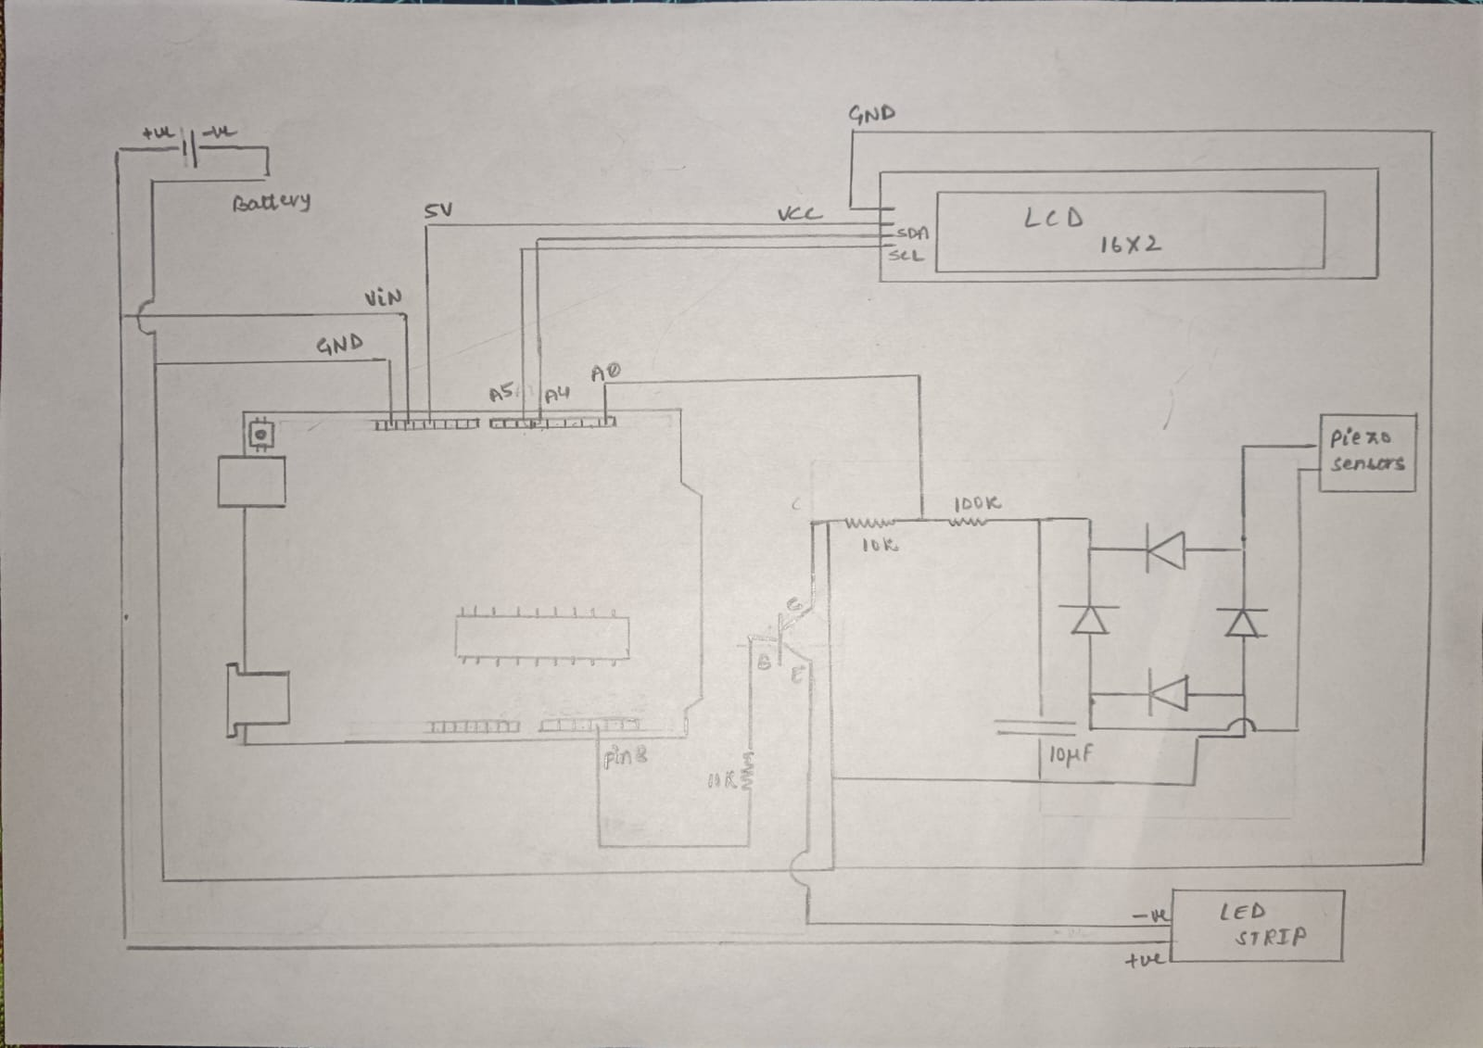
DIAGRAM

Slide 4
INTRODUCTION
The Footstep Power Generation, here we proposed a power generation technique through piezo sensors. This venture portrays the utilization of piezoelectric materials keeping in mind the end goal to collect vitality from individuals strolling vibration for producing and amassing the vitality. The essential working standard is based on piezo electric sensors. At the point when the ground surface is designed with piezo electric innovation, the electrical vitality created by the weight is caught by floor sensors and changed over to an electrical charge by piezo-electric transducer. These sensors are put such that it creates greatest yield voltage.

Slide 5
WORKING OF PIEZOELECTRIC SENSOR
A piezoelectric sensor works by converting mechanical energy, like pressure or vibration, into an electrical signal through the piezoelectric effect. This effect occurs in certain materials, such as quartz, ceramics, and some polymers, which generate an electrical charge when subjected to mechanical stress. Here's a breakdown of how these sensors operate:
1. Piezoelectric Effect
The piezoelectric effect occurs when a material generates an electric charge due to applied mechanical stress. In piezoelectric materials, atomic structure alignment changes slightly under pressure, causing a shift in charge within the material. This leads to a voltage across its surface.
The charge generated is proportional to the amount of mechanical force applied, meaning higher pressure leads to a stronger electrical signal.
2. Sensor Components
A piezoelectric sensor typically includes:
Piezoelectric material (like quartz or piezoelectric ceramics) that generates the charge.
Electrodes on both sides of the material to capture the electric charge.
Encasement or housing to protect the sensor from environmental damage and focus the pressure or force onto the material.

Slide 6
3. Working Principle
When a force (such as pressure, acceleration, or vibration) is applied to the sensor, the piezoelectric material undergoes a mechanical deformation.
This deformation generates an electrical charge that is proportional to the applied force.
The generated electrical signal is very small and often needs amplification, so it’s usually sent through a charge amplifier or conditioning circuit.
This amplified signal can then be processed by a monitoring system to interpret the force, vibration, or pressure applied.
4. Signal Processing
Because piezoelectric sensors produce AC signals, they are ideal for dynamic measurements rather than static measurements. They are commonly used for measuring changes, such as vibrations or shocks, but less effective for sustained forces because the charge will eventually dissipate.
The output signal can be further analyzed for frequency, amplitude, or waveform to understand the characteristics of the applied force or vibration.

Slide 7
WORKING PRINCIPLE
When a person steps on the piezoelectric sensor embedded in a surface (such as a floor tile), they apply a mechanical force on the sensor. This force, which can vary based on the person's weight and step, creates pressure on the piezoelectric material.
The piezoelectric effect occurs when mechanical stress or pressure is applied to certain materials (like quartz or piezoelectric ceramics), causing them to produce an electric charge.
The force from the footstep deforms the piezoelectric material within the sensor. This deformation shifts the atomic structure slightly, generating a small electrical charge across the surface of the material.

Slide 8
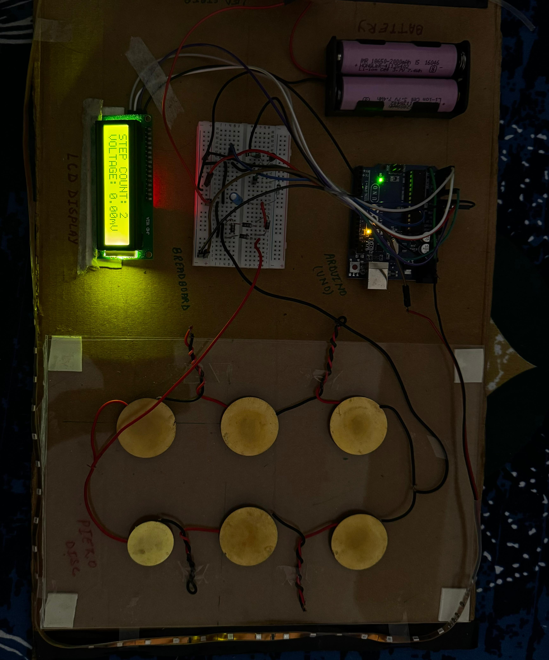
WORKING MODEL

Slide 9
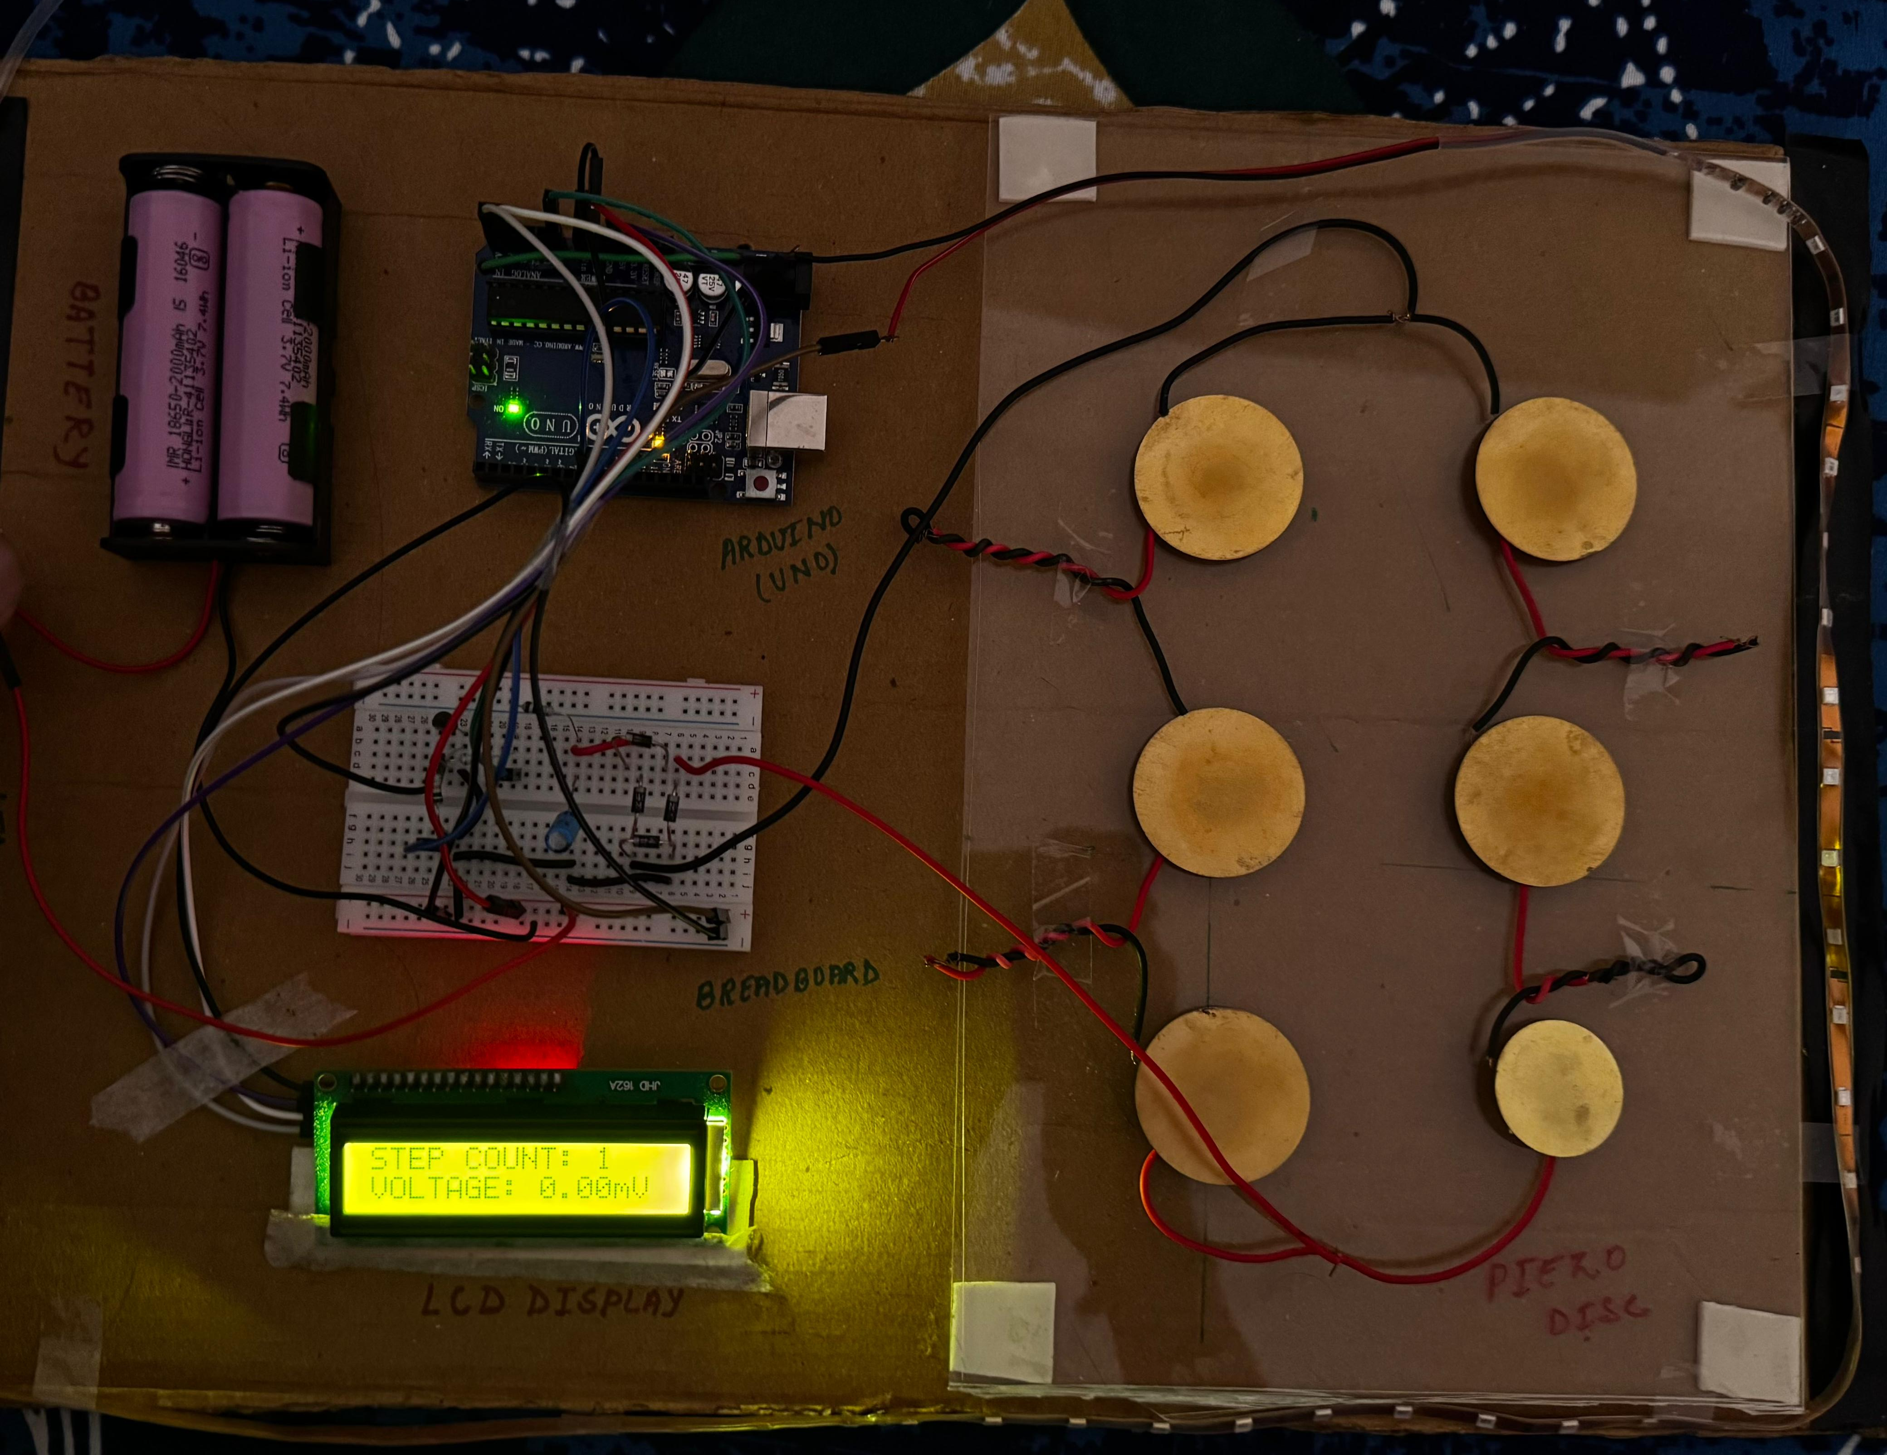
WORKING MODEL

Slide 10
Advantages
Renewable and Eco-friendly: Footstep power generation utilizes human movement, a renewable energy source, making it an environmentally friendly solution.
Energy Harvesting in High Traffic Areas: In places with heavy foot traffic, such as train stations, shopping malls, and sidewalks, a significant amount of energy can be generated over time.
Low Maintenance: Piezoelectric sensors generally require minimal maintenance since they lack moving parts, making them durable and cost-effective in the long run.
Compact and Easy to Integrate: Piezoelectric sensors are compact and can be integrated ino floors or other surfaces without requiring extensive modification, making installation relatively easy.
On-site Power Generation: The generated energy can be used for local, low-power applications like lighting or small electronic devices, potentially reducing dependency on external power sources.

Slide 11
Disadvantages
High Initial Cost: Piezoelectric materials and installation of a footstep power generation system can be costly, especially when integrating sensors over large areas.
Low Power Output per Footstep: Each footstep generates a small amount of energy, so significant energy production requires a high volume of foot traffic or a large number of sensors, limiting the system's effectiveness for higher-power applications.
Variable Output: The power generated depends on the weight and movement of each individual. Variability in steps means inconsistent power output, making it less reliable for continuous power needs.
Dependency on Foot Traffic: Energy production stops without foot traffic, so it is not a consistent or always-available power source.

Slide 12
Limitations
Unsuitable for High-Power Applications: Footstep power generation is not ideal for high-energy applications, such as powering machinery or large electronic systems, due to its low energy output.
01
Energy Loss in Storage and Conversion: Some energy is lost during conversion (AC to DC) and storage, reducing overall efficiency.
02
Limited Lifetime of Piezoelectric Materials: Although durable, piezoelectric materials can degrade over time, especially if subjected to continuous high pressure, leading to a gradual decline in energy production.
03
Dependency on Environmental Factors: Changes in environmental conditions, like extreme temperatures, can impact the performance of piezoelectric materials, potentially reducing efficiency.
04

Slide 13
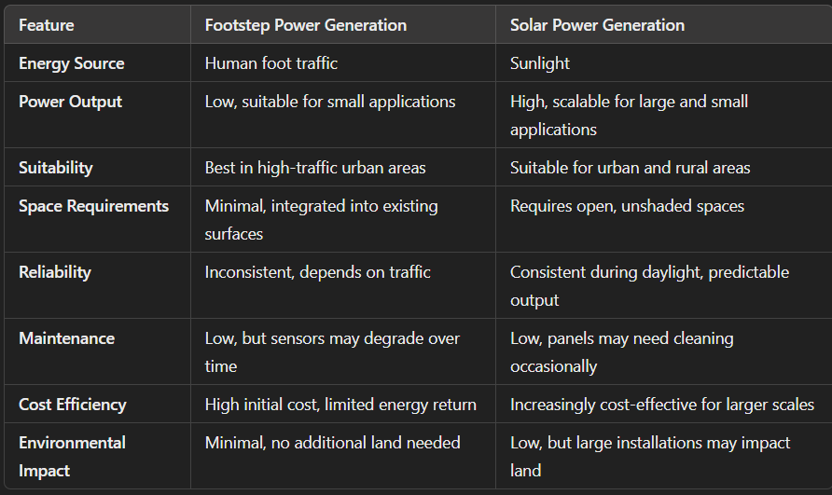
FOOTSTEP VS SOLAR
Conclusion
Footstep Power Generation is ideal for specific, low-power applications in high-traffic areas where space is limited and small-scale power is required.
Solar Power Generation is a more versatile and scalable solution, suitable for both small and large applications, and can meet high energy demands. With energy storage, it can provide a stable and reliable power source for a wide variety of needs.

Slide 14
CONCLUSION
The footstep power generation project using piezoelectric sensors offers an innovative and sustainable way to harness human movement for energy production. By converting the mechanical pressure of footsteps into electrical energy, this project provides a unique solution for generating renewable power in high-traffic areas like train stations, shopping malls, and public pathways.
While the power output from each footstep is small, collectively, it can be useful for low-power applications such as lighting, signage, or charging small devices. This method has the advantages of being eco-friendly, space-efficient, and easy to integrate into existing infrastructure. However, due to its reliance on foot traffic and limited power generation capacity, it is best suited as a supplementary energy source rather than a primary one.
In conclusion, footstep power generation with piezoelectric sensors is a promising approach to promote green energy in urban environments, offering a practical way to utilize everyday human activity for small-scale power needs. This technology also raises awareness about renewable energy possibilities, encouraging people to consider the impact of their movement and actions on sustainable energy solutions.

Slide 15
REFERENCES
https://core.ac.uk/download/pdf/236410912.pdf
https://ieeexplore.ieee.org/document/8275890
https://core.ac.uk/download/pdf/236410912.pdf
https://www.pmu.edu.sa/attachments/academics/pdf/udp/coe/dept/ee/senior%20design%20projects/foot-step_generator_report.pdf
https://www.instructables.com/ADVANCED-FOOTSTEP-POWER-GENERATION-SYSTEM/
https://www.ijltemas.in/DigitalLibrary/Vol.7Issue5/166-169.pdf

Slide 16
Literature Survey
The concept of footstep power generation has gained attention as an innovative approach to renewable energy, focusing on the potential of kinetic energy from human footsteps. The primary technology behind this idea involves piezoelectric materials, which generate electrical energy when subjected to mechanical stress. This section examines existing research, technologies, and applications related to footstep power generation systems, emphasizing the role of piezoelectric sensors, energy storage solutions, and possible uses in public infrastructure.
1. Piezoelectric Materials and Energy Harvesting
Piezoelectric materials, such as quartz and certain ceramics, exhibit the piezoelectric effect, wherein they generate an electric charge in response to mechanical stress. Recent studies have focused on improving the efficiency and durability of piezoelectric materials to maximize their energy output. Research conducted by Prasad et al. (2020) outlines how piezoelectric systems can be integrated into flooring materials in public spaces to harness energy from foot traffic. Their experiments demonstrated the potential of piezoelectric sensors in generating low-power energy suitable for small electronics Applications of Footstep Power Generation Systems Various studies and pilot projects have highlighted the practical applications of footstep power generation systems. In Japan, for instance, piezoelectric tiles have been installed in train stations to capture energy from foot traffic, which is then used to power LED displays within the facility. Similarly, the UK has implemented footstep power systems in select urban areas, contributing to energy conservation efforts while enhancing public awareness of renewable energy sources. According to Ling et al. (2021), these applications have shown that footstep power generation can supplement energy demands in high-traffic areas .

Slide 17
Literature Survey
3d Efficiency of Piezoelectric Systems
The design of an effective footstep power generation system requires a combination of piezoelectric sensors, rectifiers, capacitors, and energy storage systems. Research by Singh and Rao (2019) demonstrated that optimizing the arrangement of piezoelectric sensors can improve the overall energy output of the system. Their findings suggest that a matrix arrangement, as opposed to a series or parallel configuration, yields more consistent power generation across varied footstep pressures. Furthermore, the use of capacitors to smooth out voltage fluctuations and prevent energy loss is essential for the efficiency and stability of the system .
4. Challengtations
One of the main challenges in footstep power generation is the relatively low power output of individual piezoelectric sensors. Studies have shown that while cumulative energy from multiple footsteps can be significant, it is insufficient for high-power applications. Additionally, energy storage and battery technology limitations affect the feasibility of scaling up these systems for larger applications. Nair et al. (2020) investigated the cost-effectiveness of using piezoelectric power generation in urban settings and concluded that while initial implementation costs are high, long-term savings and environmental benefits justify the investment in suitable locations .

Slide 18
Literature Survey
5. IoT Integration fo Monitoring
Integrating footstep power generation systems with IoT (Internet of Things) technology enables real-time monitoring of energy output and performance. In recent years, wireless communication modules, such as Wi-Fi and Bluetooth, have been incorporated into these systems to transmit data on energy generation and sensor health to a central server. This feature allows for better management and optimization of the system, especially in large-scale installations. According to Zhao et al. (2022), IoT-enabled footstep power systems have proven effective in providing real-time data analytics, which is essential for urban planners and energy managers .
6.Enhanced Energy Storage and Management: Exploring advanced battery technologies, such as supercapacitors or lithium-ion batteries, could improve the efficiency and longevity of the energy storage system. Integrating a smart energy management system could further optimize the allocation of generated energy, allowing it to power larger devices or be used during peak demand times.

